Slide 1
Git
Harry Du
dumingy@cn.ibm.com
Feb 14th, 2017

Slide 2
Agenda
Basic
Workflow
Github pages
GUI

Slide 3
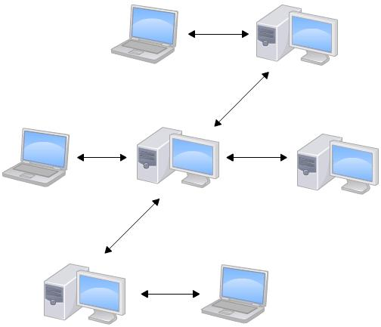
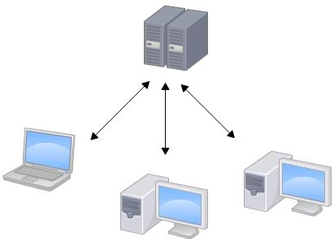
Basic
#SVN, CVS
#Git

Slide 4
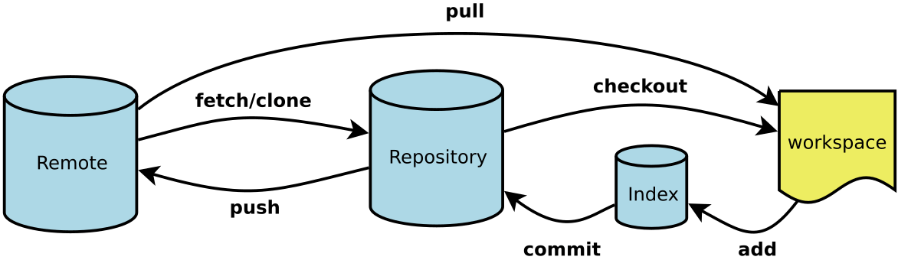
Basic

Slide 5
Basic
Workspace：工作区
Index / Stage：暂存区
Repository：仓库区（或本地仓库）
Remote：远程仓库

Slide 6
Basic
git init
git add
git commit
git log
git reset –hard HEAD^ (git reset –hard [commit_id])
git rm
git status
git checkout – [filename]
git branch
git checkout
git merge [name]
git branch –d [name]
git remote -v
git push <remote>
git pull
git fetch
git checkout –b dev origin/dev
git tag [name]
git show [tagname]
git log --pretty=oneline --abbrev-commitgit branch
git tag -d
git push origin [tagname,--tags]
git branch –d [name]
git remote -v

Slide 7
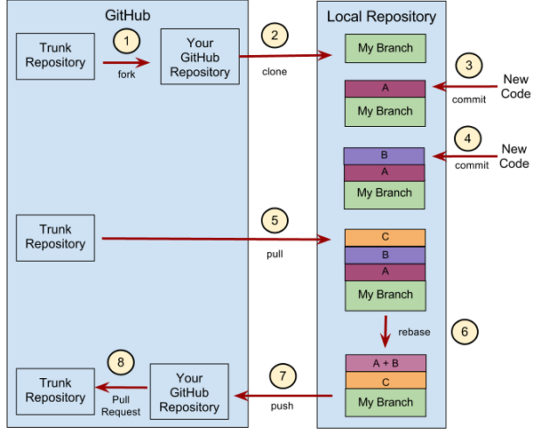
Workflow

Slide 8

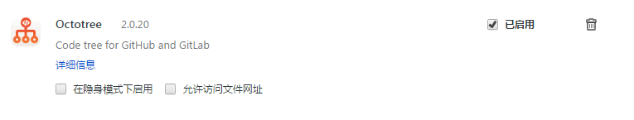
Github pages
https://pages.github.com/

Slide 9


GUI
https://git-scm.com/download/gui/linux
https://desktop.github.com/
https://www.sourcetreeapp.com/

